Slide 1
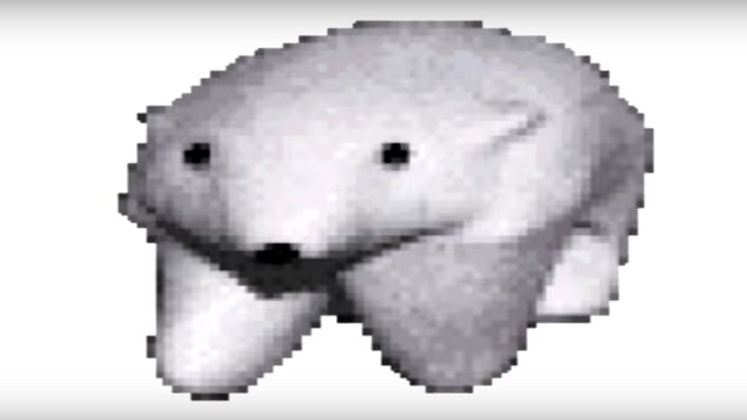
Intramolecular Forces 2: Polarity

Slide 2
Learning goals
Determine the polarity of molecules using molecular shape, understanding of symmetry, and comparison of the electronegativity of elements.

Slide 3
Vocab List
Intramolecular
Intermolecular
Valence
VSEPR
Lone Pair
Linear
Trigonal Planar
Trigonal Pyramidal
Trigonal Bipyramidal
Bent
Tetrahedral
Octahedral
Polarity
Dipole
Electronegativity
Polar
Non-polar

Slide 4
Quick Quiz
1. Draw the electron dot diagrams of the following molecules, and predict their shapes:
CCl₄ NaCl PBr₅
2. Harrison claims NCl₃ has trigonal planar geometry, but Jack believes it to be trigonal pyramidal. Explain who is correct.

Slide 5
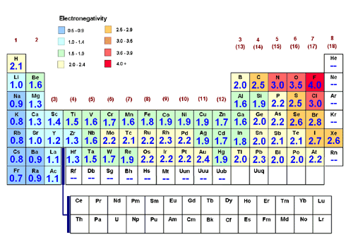
Electronegativity
Data Book Page 7 has this info too!
Notes:
Depends on number of protons, size of the atom and amount of screening due to inner electrons

Slide 6
Covalent Molecules
Covalent bonds involve the sharing of electrons (yay for sharing! Covalent = kind!!)
These electrons aren’t always shared equally (why are atoms SO MEAN?!?)
The relative electronegativities of atoms determines where electrons will spend their time
We can categorise covalent bonds into three sub types;
Non-polar
Moderately polar
Very polar
Difference in electronegativity | Type of bond
0.0 – 0.4 0.4 – 1.0 1.0 – 2.0 ≥ 2.0 | Covalent (non-polar) Covalent (moderately polar) Covalent (very polar) Ionic

Slide 7
You Do
Categorise the following bonds as non-polar, moderately polar, very polar or ionic:
C-H Non-polar
C-O Moderately polar
O-H Very polar
N-H Moderately polar
C-N Moderately polar
C-F Very polar
C-C Non-polar
Difference in electronegativity | Type of bond
0.0 – 0.4 0.4 – 1.0 1.0 – 2.0 ≥ 2.0 | Covalent (non-polar) Covalent (moderately polar) Covalent (very polar) Ionic

Slide 8
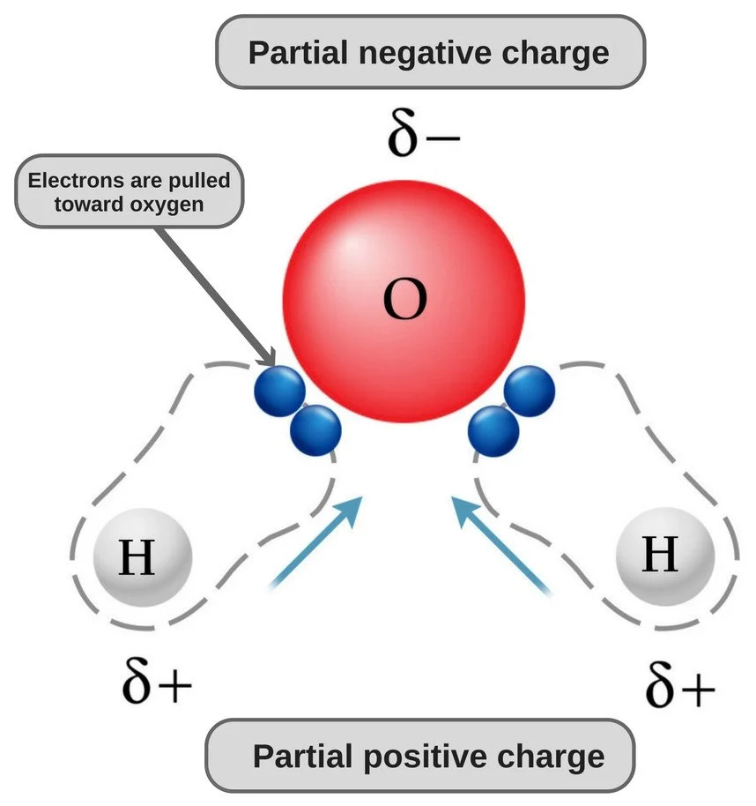
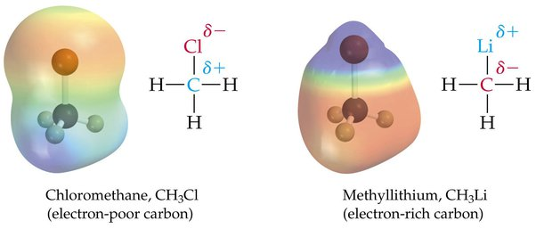

Polar Molecules
Differences in electronegativity forms areas of relative positive and negative charge
We call this a dipole (two poles) and denote these areas with delta ($δ$)
Polarity affects attraction forces between molecules, affecting the properties of a substance.

Slide 9
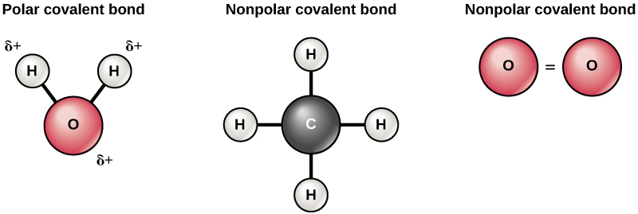
Non-Polar Molecules
Remember that it’s about differences in electronegativity between bonded atoms!
Because of the little to no difference in electronegativity, both of the below compounds are non-polar.

Slide 10
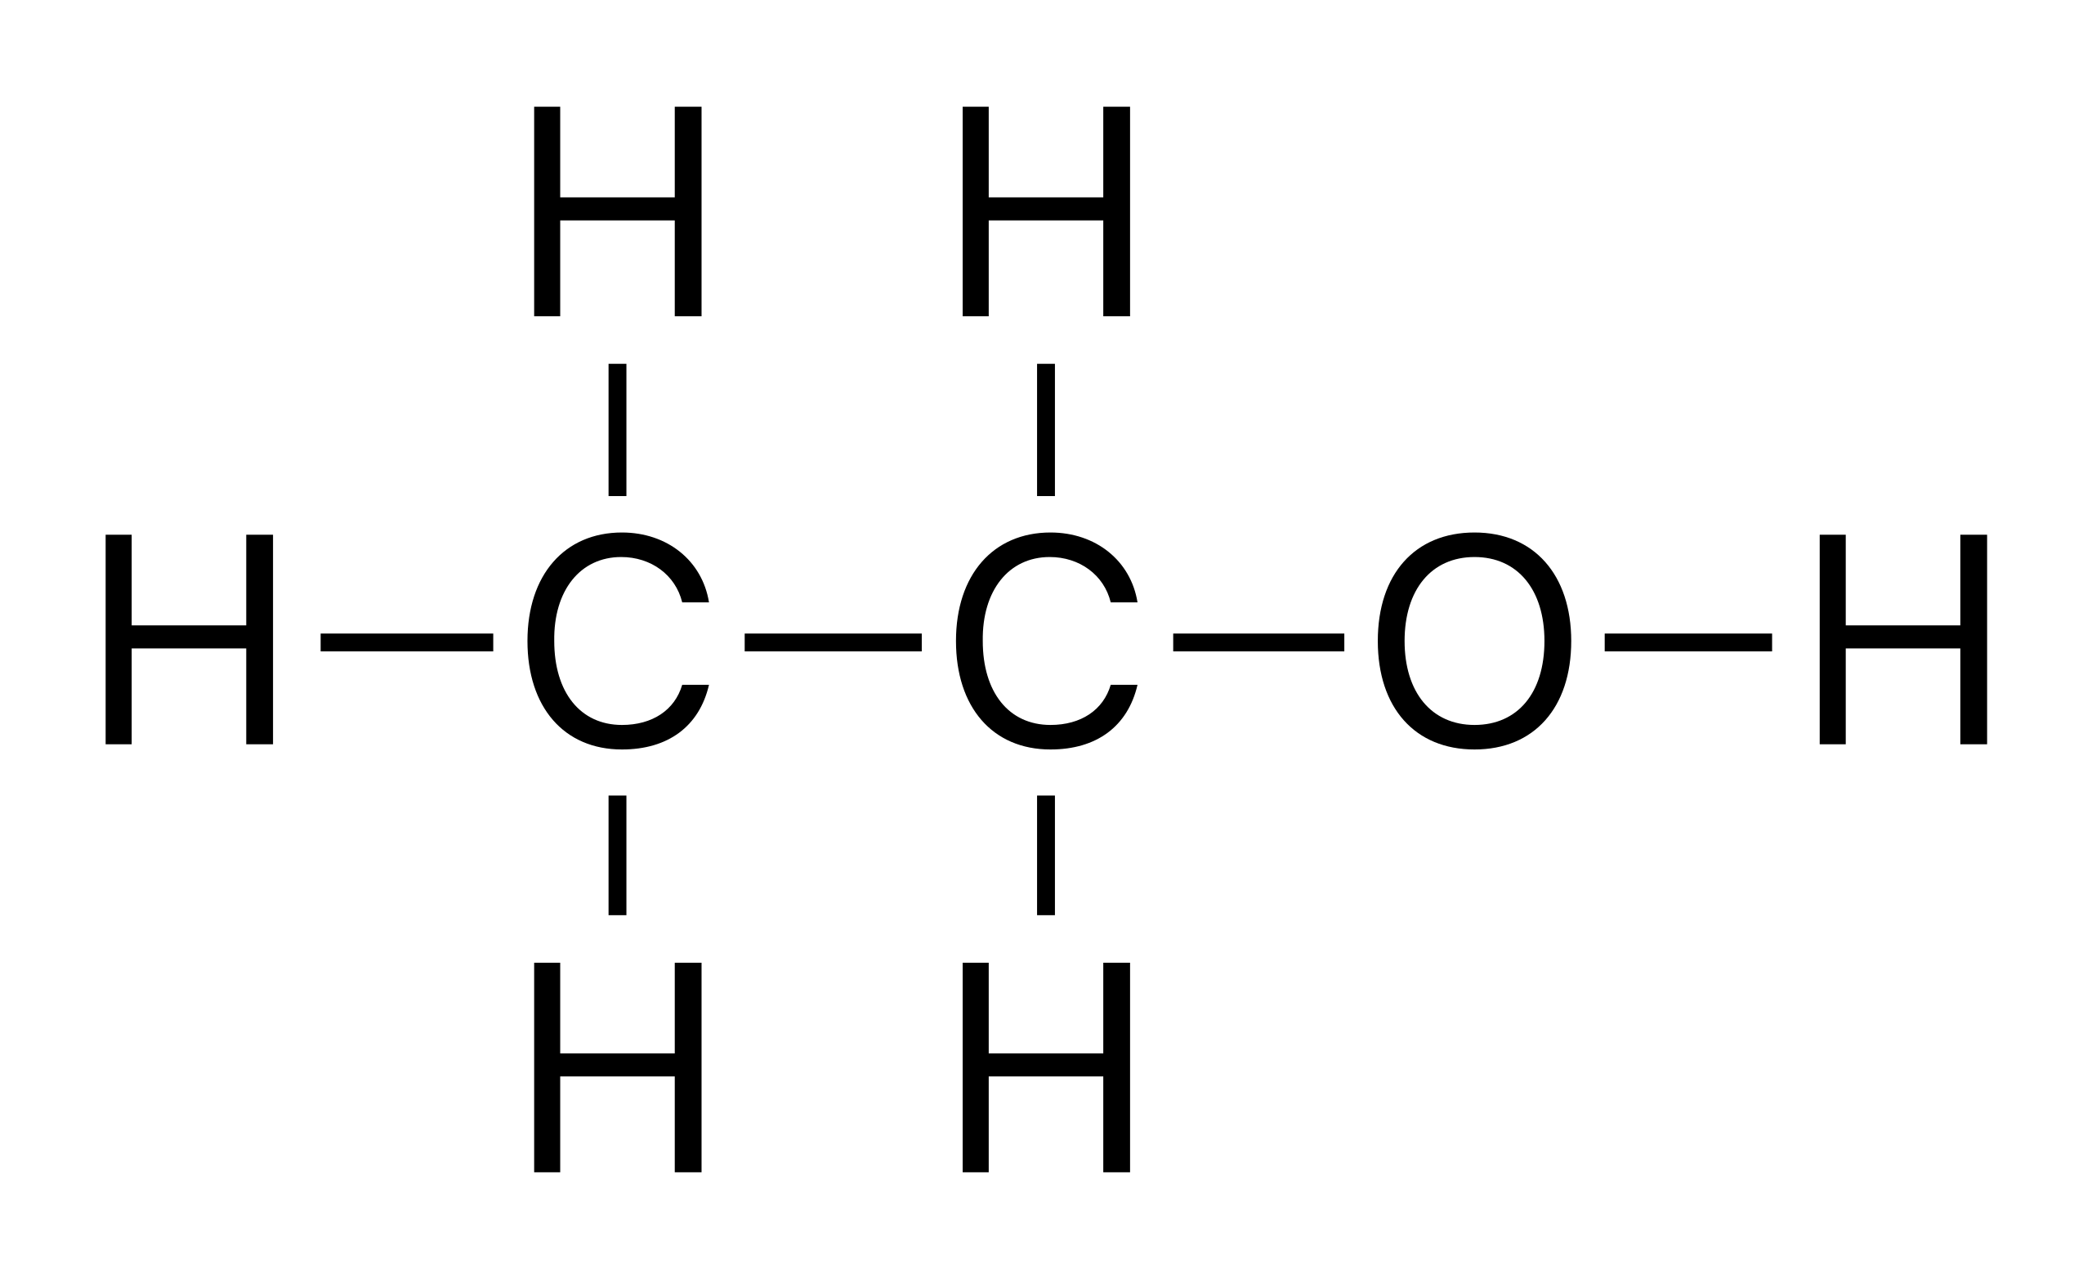
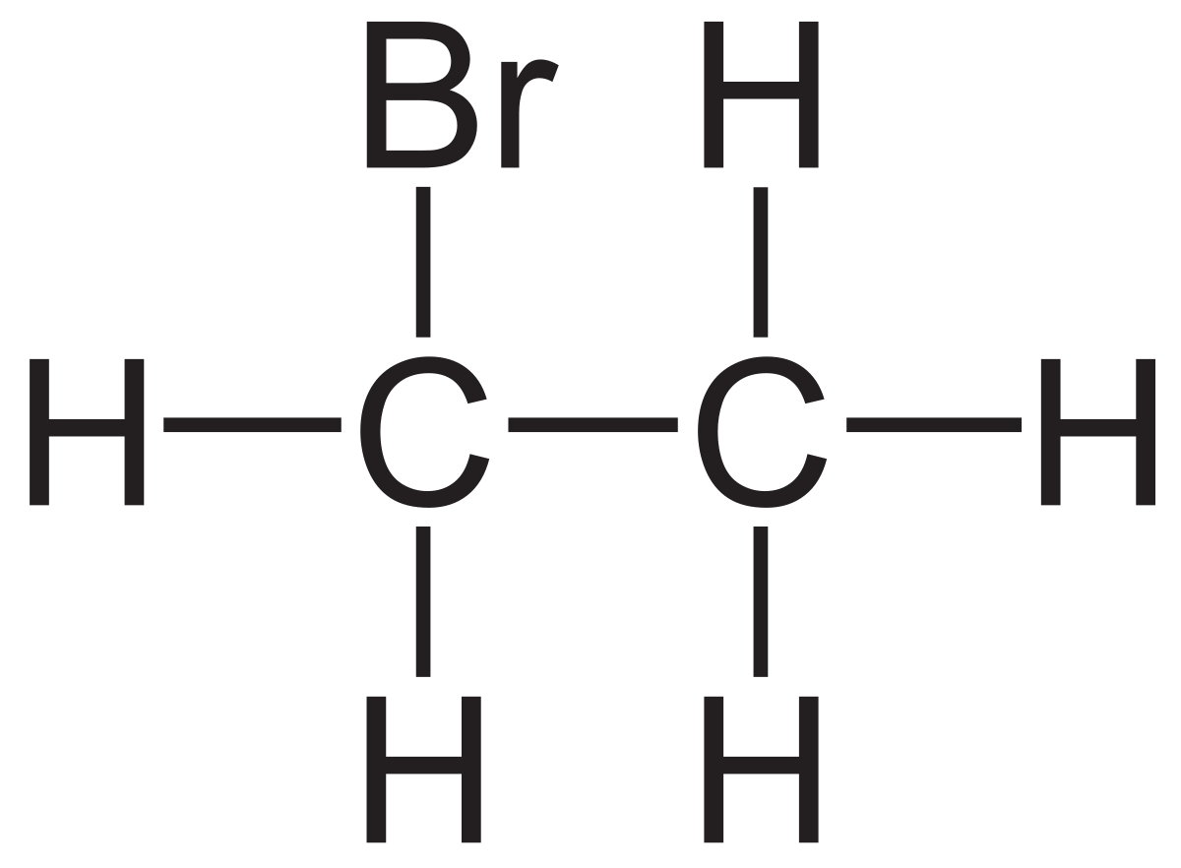
Polar Molecules
Often times only parts of a molecule will be polar. Identify the polar section on ethanol and bromoethane pictured below. Remember to keep coming back to the difference in electronegativity!

Slide 11
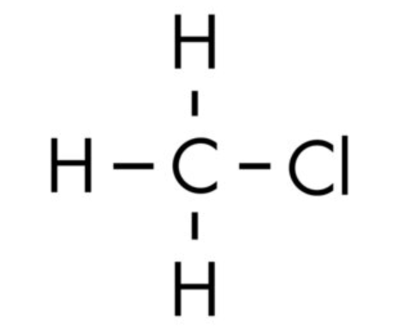
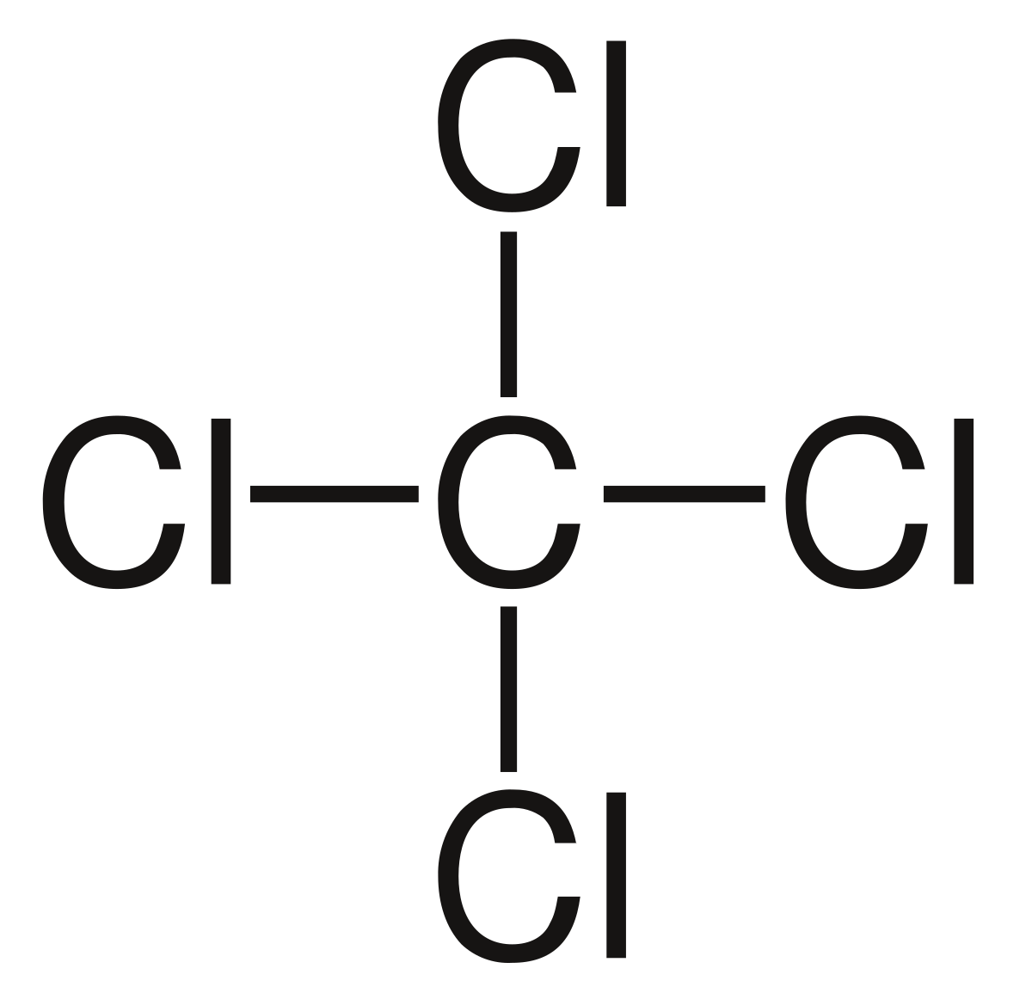
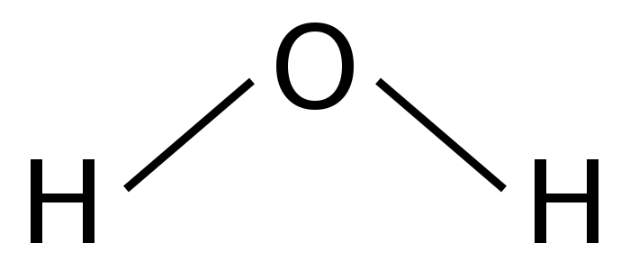
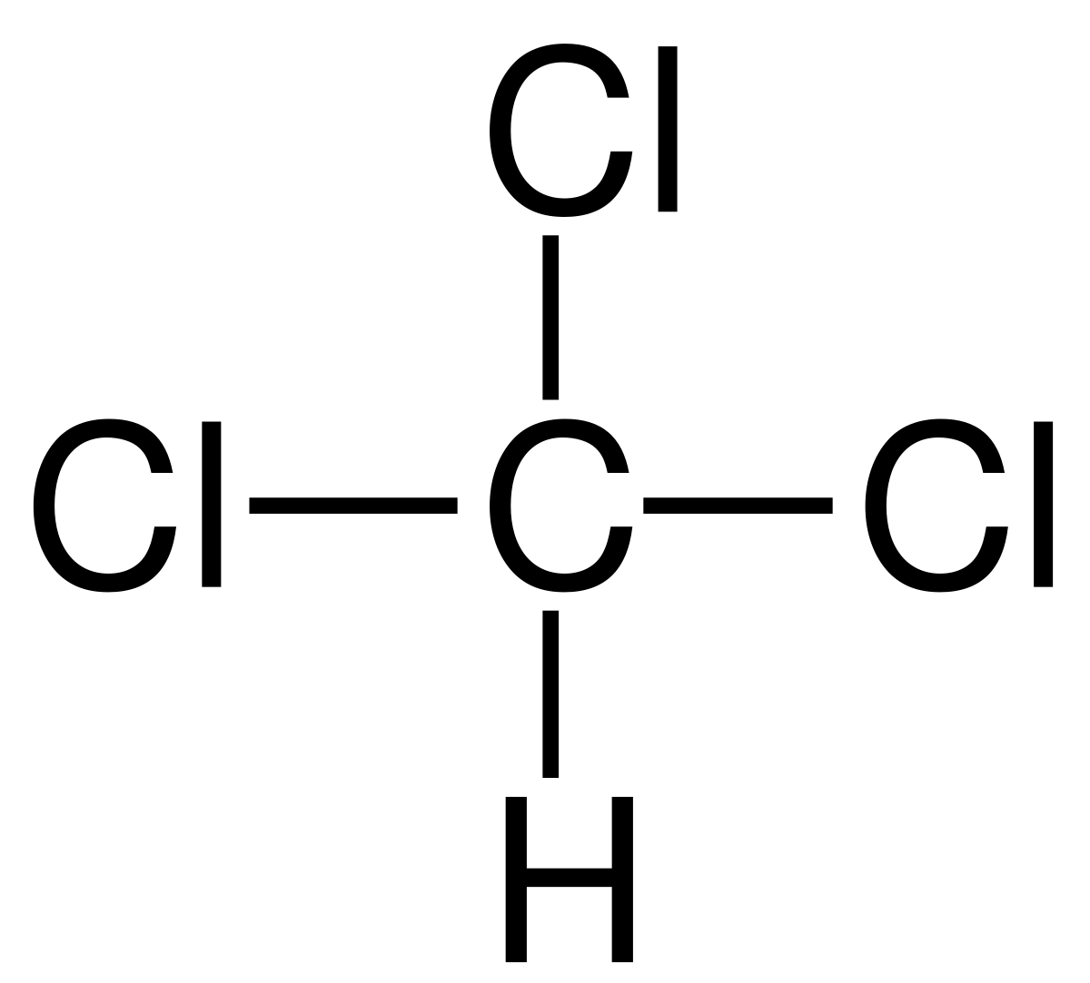
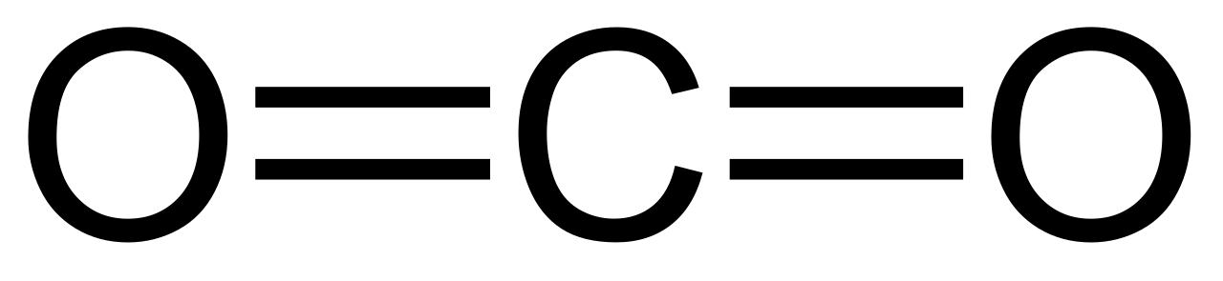
Polarity and shape
The geometry of a molecule has a big impact on polarity
Polar bonds can sometimes ‘cancel’ each other out.
Which of the following do you think are polar? Identify the polar sections, and consider whether they'll cancel each other out.

Slide 12
Your Turn
Predict the geometry of each of the following molecules and explain why the molecules are polar or non-polar:
CF₄
PF₃
HCl
H₂S
N₂
NH₃
Notes:
Tetrahedral (Central atom has 4 bonding pairs and no lone pairs) – non-polar
Pyramidal (Central atom has 3 bonding pairs and one lone pair) – polar
Linear (One bonding pair) – polar
Bent (V-shaped) (Central atom has two bonding pairs and two lone pairs) - polar
Pyramidal - polar
Planar around both carbon atoms (central atom has three bonding pairs and no lone pairs) – non-polar

